Slide 1
PRESENTATION OF RESULTS FOR THE THIRD QUARTER OF 2013

Slide 2
Table of contents
The most important events in the third quarter of 2013
Factors affecting Company activity
Apartment sales in quarters I - III of 2013
Chosen consolidated financial data for the third quarter of 2013
Chosen consolidated financial data cumulatively for in the third quarter of 2013
Gross sales margin vs gross profit on sale
Realization of gross profit from the sales in the III quarter of 2013
Overheads vs employment
Premises in the offer to be recognized in the result in further quarters
Investments realized in III quarter of 2013
Investments planned to be run
The most important marketing events in the third quarter of 2013
Marketing and sale policy in the third quarter of 2013
Designs planned to be run at the turn of 2013 and 2014
Notes:
Here, I have added 2014 in the last paragraph.
I wonder if I should remove this strategy.

Slide 3
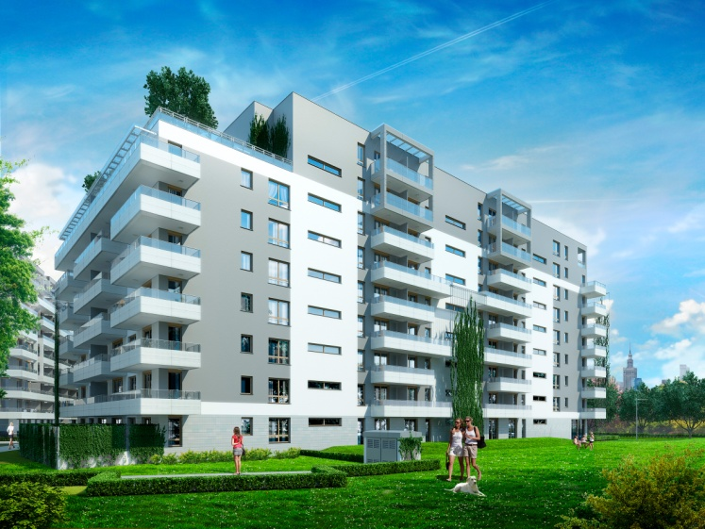
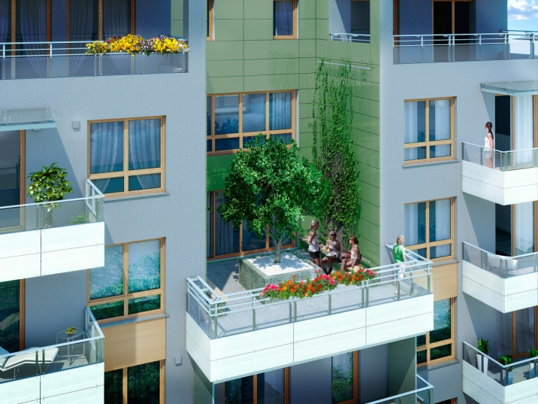
The most important events in the third quarter of 2013
Bliska Wola investment, I stage:
Start of the investment construction:
in target 156 premises, 7 716 sq. m. of useable area
Starting the trust open account
Sales start:
in September (first month of sale) the result of 46 sold premises has been achieved

Slide 4
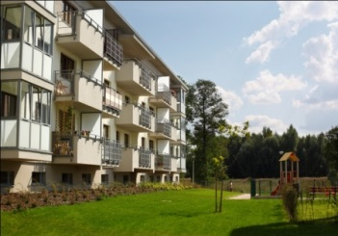
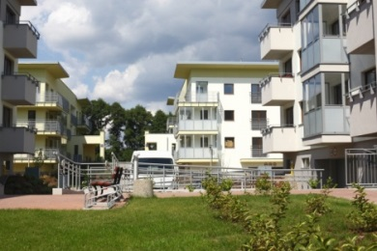
The most important events in the third quarter of 2013
Obtaining buidling permit:
I stage of investment at Bałycka street in Katowice
II stage of Nowe Tysiąclecie investment in Katowice (temporary building permit)
II stage of Nowe Tysiąclecie investment in Katowice (temporary building permit)
6 single-family houses at Villa Campina housing development
Start of II edition of „Struggle for home” program, realized at Zielona Dolina housing development and emitted in TVN, where J.W. Construction Holding S.A. is the Partner and Patron of the main award.
Investment | Data on the investment
 | Number of premises | PUM
I stage of investment at Bałycka street in Katowice | 162 | 10,194 m²
I stage of investment Nowe Tysiąclecie in Katowice | 149 | 7,085 m²
II stage of investment Nowe Tysiąclecie in Katowice | 149 | 7,085 m²
6 single-family houses at Villa Campina housing development | 6 | 1 072 m²

Slide 5
Factors that affect the Company activity
Maintained low interest rates of mortgages with the factor which is favourable for customers who apply for the credit.
Principles of a new program of rental flats fund are included in the offer of Company premises.
Major interest in purchaseof flats for the investment purposes.
Making (in September) the program called Mieszkanie dla Młodych the factor which develops the demand since 2014.
Running an intensive marketing and advertising actions guided on the sale of finished premises.
POSITIVE

Slide 6
Factors that affect the Company activity
NEGATIVE
Development law which makes it more difficult to among others fund new investments.
Developer branch percepted by the financial institutions as high risk branch.
Lack of government program to support purchasers in 2013.
Long-lasting processof obtaining necessary administrative decisions in relation to the currently ongoing and future projects.

Slide 7
Sale of flats in the I - III quarter of 2013
Only in the third quarter, the Company sold 275 premises.
J.W. Construction Holding S.A. within three quarters of 2013 sold 669 premises, what is 22 proc. more than in the same period of the previous year.
* Data concerning sale include the sales of „Oxygen” investment (36 premises in Q I-III 2012, 90 premises in Q I-III 2013)

Slide 8
Chosen consolidated financial data for Q3 of 2013
Chosen financial data | The third quarter of 2012 | The third quarter of 2013 | Quarter to quarter change
Profit on sale | PLN 56.0 mln | PLN 77.1 mln | 38%
Gross profit on sale | PLN 7.7 mln | PLN 18.6 mln | 142%
Gross margin on sale | 14% | 24% | 10p.p.
Proft on operating activities | PLN 1.4 mln | PLN 11.6 mln | 729%
Net profit | - PLN 6.0 mln | PLN 2.3 mln | -
Increase of profit on sale in the third quarter of 2013 by 38% in comparison to analogous period in previous year.
Net profit in the third quarter of 2013 was PLN 2.3 mln.
Notes:
LACK OF DATA

Slide 9
Chosen consolidated financial data in growing after three quarters of 2013
Chosen financial data | In growing for the third quarter of 2012 | In growing for the third quarter of 2013 | Period to period change
Profit on sale | PLN 211.4 mln | PLN 258.4 mln | 22%
Gross profit on sale | PLN 51.3 mln | PLN 57.3 mln | 12%
Gross margin on sale | 24% | 22% | -2 p.p.
Proft on operating activities | PLN 41.5 mln | PLN 35.9 mln | -13%
Net profit | PLN 2.5 mln | PLN 7.4 mln | 196%
Increase of profit on sale in growing after the third quarter of 2013 by 22% in comparison to analogous period in previous year.
Increase of net profit in growing after the third quarter of 2013 by 196% in comparison to analogous period in previous year.
Notes:
LACK OF DATA

Slide 10
Margin in gross from the sale vs gross profit on sale
Margin in gross on sale within the long period of time is maintained at the level above 20%.

Slide 11
Realization of gross profit from the sales in the III quarter of 2013
The level of gross profit generated from sale for three quarters of 2013 is PLN 57.3 mln. Percentage of development designs recognized in the profit on sale:
Premises recognized in the result for three quarters of 2013 vs. three quarters of 2012
Notes:
Lack of data

Slide 12
Overheads vs employment
417***
Number of people
Including employment in hotels:
* 86 people
** 163 people
*** 153 people
Notes:
We are waiting for data

Slide 13
Premises (in pieces) in the offer to be recognized in the result in further quarters
223
sold premises
not transferred
Notes:
Lack of data

Slide 14
Investments realized in III quarter of 2013
In the third quarter of 2013, there were in total 393 premises with the total surface of 20.752 m² implemented in residential investments
End preparations to implement Nowe Tysiąclecie investment in Katowice for sale (149 premises)
Housing investments | Name of the design | Number of premises | PU (m²)
Realized - residential | Rezydencja Redłowo, Gdynia | 52 | 3 259
 | Oaza Piątkowo, Poznań | 183 | 9 422
 | Bliska Wola, Warszawa | 156 | 7 716
 | Villa Campina – houses, Ożarów | 2 | 355
 | IN TOTAL | 393 | 20 752
Notes:
We removed Oxy and inserted Bliska Wola
Until the permission validation you should insert Katowice, Bałtycka street

Slide 15
Investments planned to be run as at 30 September 2013
During two years, on the basis of the land bank, the Company is planning to launch the realization of more than 6.000 premises:
Investments in Warsaw and in the vicinity
Investment | Number of premises | PUM
Warszawa, Bliska Wola stage II * B1 | 666 | 30,695 m²
Warszawa, Bliska Wola stage II * B2 | 291 | 12 973 m²
Warszawa, Bliska Wola stage III | 481 | 21 183 m²
Warszawa, Bliska Wola street, stage IV | 525 | 23 600 m²
Warszawa, Bliska Wola stage V | 733 | 33 000 m²
Warszawa, Zielona Dolina II | 864 | 38 258 m²
Warszawa, Berensona street* | 263 | 11,874 m²
Warszawa, Antoniewska street | 221 | 13,864 m²
Investment | Number of premises | PUM
Warszawa, Aluzyjna street I | 30 | 1,800 m²
Warszawa, Aluzyjna II | 68 | 4 080 m²
Warszawa, Odkryta II | 82 | 4 158 m²
Warszawa, Osada Wiślana | 21 | 928 m²
Warszawa, Zielona Dolina III | 44 | 2 256 m²
Warszawa, Nowodworska street | 28 | 1,600 m²
Warszawa, Mikołaja Trąby street | 73 | 3 489 m²
Villa Campina – houses, Ożarów* | 10 | 1 870 m²
In total | Number of premises 4 400 | PUM 205 628 m²
* Investments planned to be run at the turn of 2013 and 2014
Notes:
Data to be corrected

Slide 16
Investments planned to be run
Investments beside Warsaw
Investment | Number of premises | Usable space
Katowice, Nowe Tysiąclecie stage I* Facility A1 | 149 | 7 085m²
Katowice, Nowe Tysiąclecie stage II Facility B1 | 149 | 7 085 m²
Katowice, Nowe Tysiąclecie stage III | 329 | 16,175 m²
Katowice, Bałtycka street, stage I | 162 | 10 194 m²
Katowice, Bałtycka street, stage II | 74 | 4 295 m²
Gdynia, Spokojna street, stage II | 236 | 13 614 m²
Gdynia, Spokojna street, stage I * | 196 | 11 485 m²
Łódź, Tymienieckiego street III* | 95 | 4 784 m²
Gdynia, Sochaczewska street | 55 | 3 478 m²
In total: | 1 445 | 78,195 m²
* Investments planned to be run at the turn of 2013 and 2014
Notes:
Data to be corrected

Slide 17
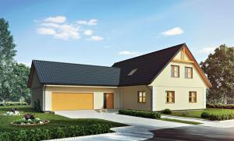
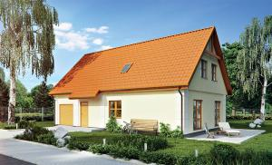
The most important marketing events in the third quarter of 2013
Introduction to the sale of Bliska Wola investment – investment located in the excellent location
Promotion of 2 new Villa Campina houses - designs are the response for the market demands as regards price and standard („Margarita” and „Anita” houses)
Continuation of sponsoring actions directed on the promotion of Company investment and image strenghtening – realization of TVN program – „Struggle for home” in Zielona Dolina investment.
Notes:
Logo Villa will be inserted instead of Struggle!

Slide 18
Marketing and sale policy in the third quarter of 2013
Focusing the marketing and adevertising strategic actions on the internet marketing field.
Participation in trade ventures and events of business and recreation, eg.: presentation of Rezydencja Redłowo on Wind and Water event in Gdynia.
Introduction for Oxygen investment Oxygen Residence program, making it possible to use the comprehensive program of rental management.
Leading campaigns directed on the sale of premises that are fully ready to reside in Warszawa, Ożarów Mazowiecki and Łódź.

Slide 19
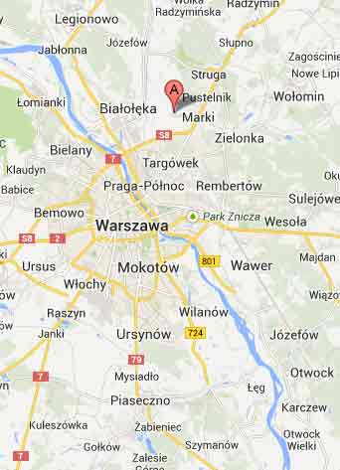
Designs planned to be run at the turn of 2013 and 2014: Warszawa, Berensona street
Design | Warszawa, Berensona street
Location | Warszawa, Berensona street
Number of flats | 263
Useable area (in sq. m.) | 11 874
Design net value (in mln of PLN) | 66
Characteristics
the design covers 12 facilities low, prestige development located on Białołęka– the most resiliently developing district in Warsaw safe playgrounds within the are of housing development proximity of agglomeration conveniences: schools, kindergartens, shopping centres quick commute to the city center

Slide 20
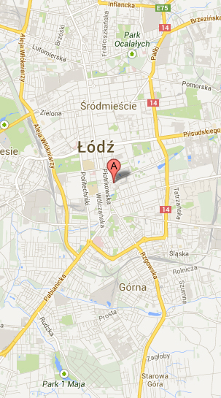
Designs planned to be run at the turn of 2013 and 2014: Łódź, Tymienieckiego street III
Design | Łódź, Tymienieckiego street
Location | Łódź, Tymienieckiego street
Number of flats | 95
Useable area (in sq. m.) | 4 784
Design net value (in mln of PLN) | 28
Characteristics
the design covers 3 facilities with max. 7 storeys presitge location in the historic area of Łódź wide choice of metric areas and rooms arrangements enclosed and supervised area safe playgrounds

Slide 21
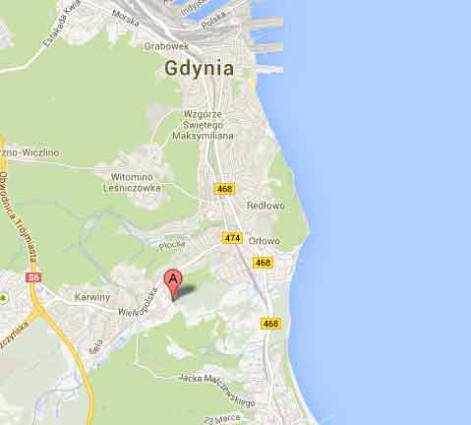
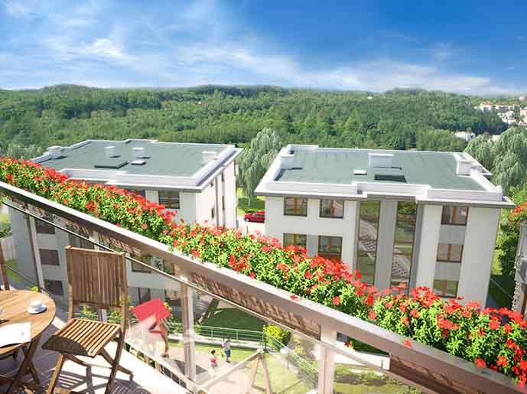
Designs planned to be run at the turn of 2013 and 2014: Gdynia, Spokojna street, stage I
Design | Gdynia, Spokojna street
Location | Gdynia, Spokojna street
Number of flats | I stage 196
Useable area(in sq. m.) | I stage 11,485
Design net value (in mln of PLN) | 65
Characteristics
attractive location - vicinity of Leśna and Spacerowa streets low, cosy development wide choice of metric areas and rooms arrangements the design of rooms arrangement allows for any interiors arrangement proximity of beach and Trójmiejski Park Krajobrazowy

Slide 22
Designs planned to be run at the turn of 2013 and 2014: Bliska Wola, Stage II
Design | Bliska Wola
Location | Warszawa, Wola
Number of premises | 957 at the II stage
Useable area (in sq. m.) | II stage 43 668
Service – trading – offices (in sq. m.) | as a target - more than 70 000
Design net value (in PLN mln) | approximately 298 for II stage,
Characteristics
great location - only 3 km from the strict center of the city very well developed communication infrastructure - subway station since 2014 recreational area inside the housing development interesting and modern facilities architecture competitive prices of flats

Slide 23
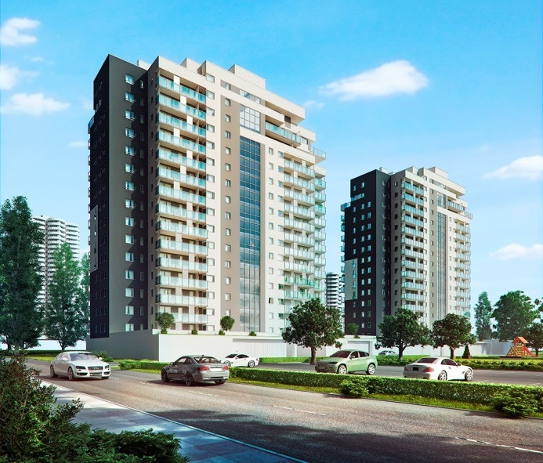
Designs planned to be run at the turn of 2013 and 2014: Nowe Tysiąclecie, Stage I
Design | Nowe Tysiąclecie
Location | Katowice
Number of flats | I stage 149
Useable area(in sq.m.) | I stage 7,085
Design net value (in mln of PLN) | 37
Characteristics
as a target the design should cover five 17-storey residential and office facilities modern architecture – numerous glazing attractive location allows for convenient and quick communication with centre terrain development includes numerous shrubs and trees wide scope of metric area selection vicinity of green terrains, including Park Śląski (the biggest city park in the Europe)

Slide 24
Thank you for your attention
INVESTOR RELATIONS:
Małgorzata Szwarc-Sroka
Director of the Economic Department
and Director of the Investor Relations Office J.W. Construction Holding S.A.
Member of the Board of J.W. Contruction Sp. z o.o.
tel.: 22 771 77 85 e-mail.: relacje.inwestorskie@jwconstruction.com.pl

